Slide 1
Bedside Medication Delivery Program
ARN meeting
June 2, 2021

Slide 2

About the PROGRAM
GOAL
  To improve the workflow and communication around the process for patients obtaining their discharge medications from the MGH Outpatient Pharmacy, using Epic functionality
STAKEHOLDERS
  Nurses. Unit Coordinators. Case Managers. Providers. Inpatient pharmacists. Outpatient pharmacists. Patients and their care-givers.
Implementation Plan Pilot – October 2020 on Ellison 19 & White 10 Phased roll-out January – February 2021 Ellison 7, White 7, Ellison 12 April – May 2021 Bigelow 9, Bigelow 14, White 8, White 9, Ellison 16 Summer 2021 OB and remaining medical units, timing TBD Fall 2021 units TBD | Project Leads for Implementation Pharmacy: Fiona Cheung/Tas Spracklin Nursing Informatics: Shelly Stuler

Slide 3
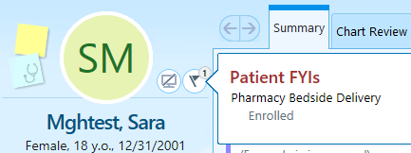
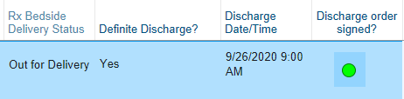
Process overview
Epic FYI flag indicates enrollment in program. Status in program can be viewed by any care team member in the Patient FYI section, or in the “RX Bedside Delivery Status” column on their Patient List
Interdisciplinary rounds include discussion of patient’s discharge planning, including enrollment in this program
Patient list columns are updated and viewed by the inter-disciplinary team to indicate timing of patient’s discharge and status of prescription being filled

Slide 4
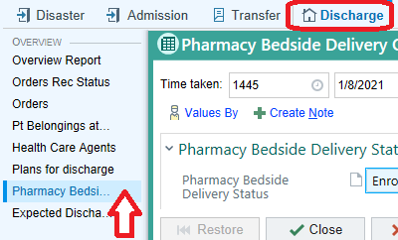
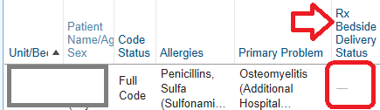
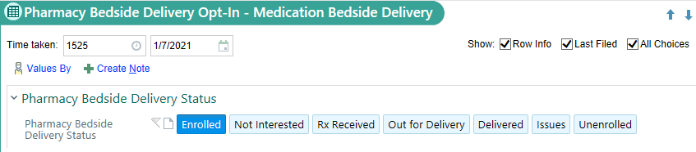
Nursing Workflow
Enrollment
  Discuss Bedside Medication Delivery program with patient/family
  Document Enrollment via Navigator (Admission or Discharge) or by double-clicking into the cell in the Patient List column

Slide 5
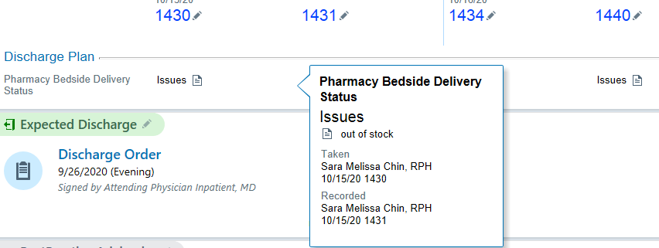
Nursing Workflow
Discuss enrollment during inter-disciplinary rounds
Communicate with Unit Coordinator about patient’s discharge status
View the Rx Bedside Delivery Status column for updates on Rx status
        Column will need to be added into “My List”
        Status can also be viewed by hovering over Patient FYI Flag
        NOTE: Pharmacy will also be viewing, updating and entering comments on Rx Status
Epic enhancement request to add new view for nursing to more easily see Status and Comments – expected with June release

Slide 6
Case manager Workflow
1. Discuss enrollment during inter-disciplinary rounds
  NOTE: This program is available Monday – Friday, 9a-5p
2. Update the expected discharge date and time daily at rounds

Slide 7
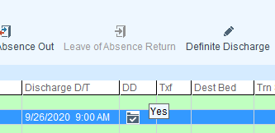
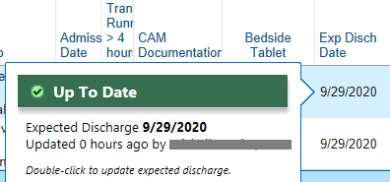
Unit Coordinator Workflow
1. Manage the Definite Discharge Date
2. If needed, update the Expected Discharge Date date/time field to match Definite Discharge date/time
3. If needed, add the Rx Bedside Delivery Status column to your patient list

Slide 8
Provider Workflow
1. Discuss enrollment during inter-disciplinary rounds
  Provider can ask ARN to enroll patient
2. Enter discharge medication orders (prescription)
  BPA fires if MGH OP Pharmacy has not been selected
    MGH OP pharmacy staff monitors list of enrolled patients and updates the pharmacy information in Epic
  Enter prescription orders as soon as possible, at least 1-2 hours prior to discharge

Slide 9
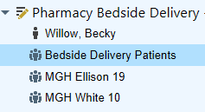
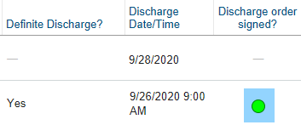
Pharmacy Workflow
1. Monitor enrolled patients through the “Bedside Delivery Patients” List
  Unenroll patient if transferred to a non-participating unit
2. Update the patient’s pharmacy to MGH Outpatient Pharmacy
3. Triage workflow based on “Definite Discharge?” “Discharge Date/Time” and “Discharge Order” columns, to process discharge prescriptions

Slide 10
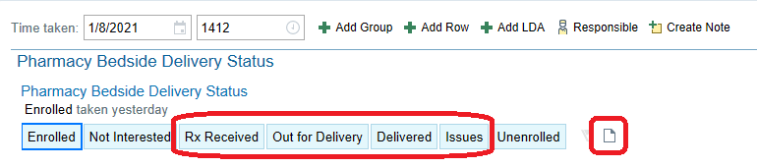
Pharmacy workflow
4. Update “Rx Bedside Delivery Status” as appropriate
    Note: any issues (PA needed, medication not available, etc.) will be primarily communicated via page/call to providers. Comments will be left as an FYI to other stakeholders

Slide 11
Program Success
Patient Safety and Patient Satisfaction
Ensures that patients receive their meds
Payment for co-pay is taken by OP Pharmacy via phone or in person
ARN Workflow
Improves communication between ARN and OP Pharmacy
Keeps ARN from needing to wait at the OP Pharmacy
Discharges
Does not negatively impact discharge times
OP Pharmacy communicates directly with Provider as needed (e.g., Prior Authorization)

